Slide 1

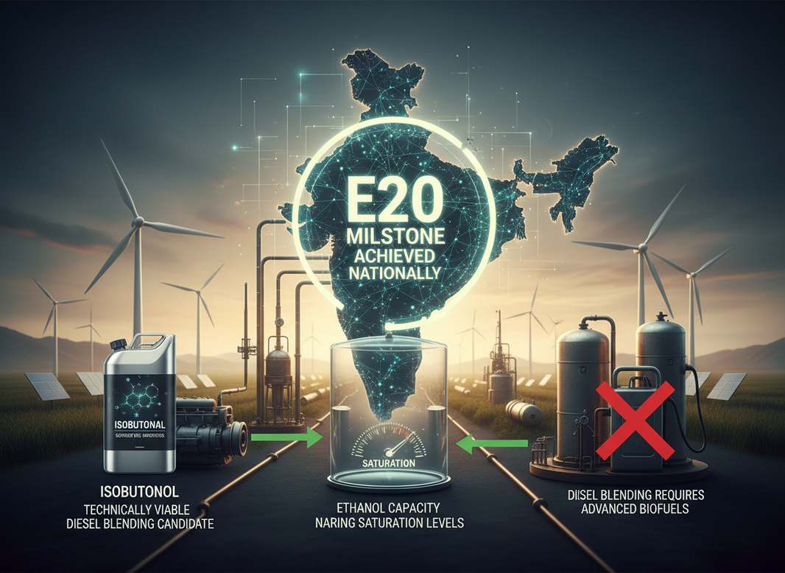
Biofuel
Blending Isobutanol-The Future
Presented by AIDA- All India Distillers’ Assocation

Slide 2

Strategic Context
Biofuel Landscape and Isobutanol Motivation
E20 Milestone
Diesel Needs
The national E20 ethanol blending milestone has advanced significantly, showcasing the growing integration of biofuels and the transition towards more sustainable fuel options in the transportation sector.
The diesel sector urgently requires advanced biofuels, as conventional options are insufficient for achieving the necessary decarbonization targets, making isobutanol a compelling solution for improved performance.

Slide 3

Key Advantages
Technical Benefits of Isobutanol
Energy Density
Storage Stability
Phase Compatibility
Isobutanol offers a 30% increase in energy density compared to ethanol, making it a more efficient choice for blending with diesel, supporting better performance and energy output.
Due to its low hygroscopicity, isobutanol ensures better storage stability, minimizing moisture absorption and enhancing long-term viability within diesel fuel systems, thus reducing maintenance concerns.
The minimal phase separation in diesel blends with isobutanol leads to improved compatibility, ensuring smoother fuel integration and consistent performance across a variety of operational conditions.

Slide 4
Production Pathways Overview
Fermentation
Utilizes engineered yeast strains to convert sugars from biomass into isobutanol, with near-commercial viability.
Catalytic
Involves chemical reactions of ethanol and methanol, requiring advanced reactor systems for optimal isobutanol production.
Integration
Both pathways can leverage existing biofuel infrastructure, enhancing overall efficiency and sustainability in fuel production.

Slide 5
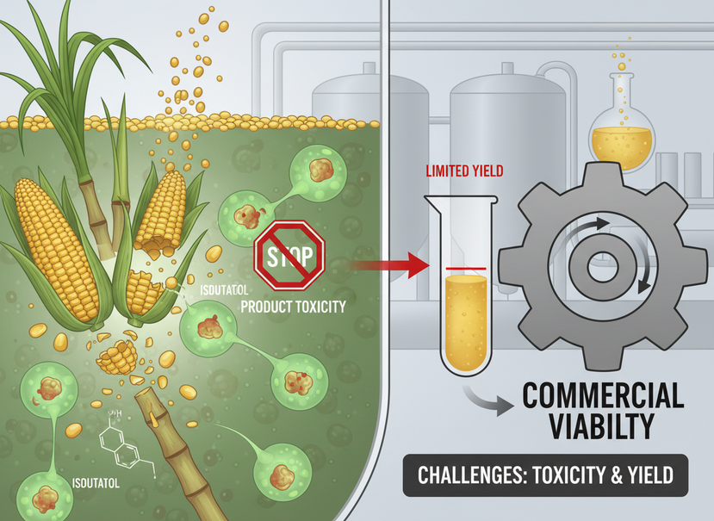
Fermentation Route
Producing Isobutanol Biologically
Engineered Yeast
Engineered yeast strains utilize grains and sugars as feedstock for isobutanol production, although challenges such as product toxicity and yield limitations must be addressed for commercial viability.

Slide 6
Cross Guerbet Catalytic Route
Catalytic Efficiency
The Cross-Guerbet catalytic route enables the condensation of ethanol and methanol with over 90% selectivity, optimizing energy output through advanced reactor temperature control and hydrogenation processes.

Slide 7
Yield and Efficiency
Advantages of Blending Isobutanol with Diesel
Energy Output
Resource Optimization
Lifecycle Performance
Isobutanol boasts a higher volumetric energy output, allowing for improved diesel blending ratios and enhancing overall fuel efficiency while maintaining performance standards in various engine types.
The integration of methanol in isobutanol production optimizes resource utilization, significantly reducing the need for additional fuel additives while maximizing energy efficiency in diesel blends.
Isobutanol blends demonstrate improved lifecycle carbon performance compared to traditional ethanol blends, contributing to lower greenhouse gas emissions and supporting environmental sustainability in the diesel sector.

Slide 8
Process Integration
Opportunities for Isobutanol Blending
Retrofit Potential
Synergies with Methanol
Infrastructure Compatibility
Existing ethanol plants can be retrofitted to integrate isobutanol production efficiently, leveraging current infrastructure to enhance biofuel output and support sustainability goals in the diesel sector.
Integrating green methanol co-production alongside isobutanol offers synergistic benefits, optimizing resource utilization and maximizing the overall efficiency of biofuel production processes within existing facilities.
The compatibility of isobutanol with current fuel distribution networks allows for seamless blending, ensuring that supply chains can adapt without significant modifications to existing systems or logistics.

Slide 9
Technical Challenges
Obstacles to Isobutanol Deployment
Microbial Toxicity
Separation Complexity
Production Costs
Microbial toxicity poses a significant challenge, limiting fermentation yields and reducing the overall efficiency of isobutanol production, necessitating advanced solutions to mitigate these effects on production processes.
The downstream separation processes for isolating isobutanol are complex and costly, presenting hurdles that must be addressed to streamline production and improve economic feasibility for commercial use.
High production costs remain a barrier to widespread adoption, requiring innovative approaches in technology and process optimization to enhance the economic viability of isobutanol as a diesel blendstock.

Slide 10
Technical Outlook
Roadmap Toward Commercialization
Pilot Scale Validation
Comparative Assessments
Emission Testing
Conducting pilot-scale validation will help assess the technical viability of isobutanol production methods, ensuring they meet industry standards and advancing towards commercialization in the biofuel sector.
Comparative assessments between fermentation and catalytic routes will clarify advantages and potential drawbacks, guiding strategic decisions for investment and research focus in isobutanol production technologies.
Ongoing emission reduction and engine performance testing will evaluate the impact of isobutanol blends on existing diesel engines, ensuring compliance with environmental regulations and enhancing market acceptance.

Slide 11
Policy Recommendations
Strategies for Supporting Biofuel Integration
Financial Support
Infrastructure Upgrades
Standards Development
It is essential to provide funding for pilot projects demonstrating isobutanol blending to validate outcomes and encourage innovation in biofuel development across various sectors and applications.
Stakeholders should promote retrofitting existing ethanol plants for isobutanol integration, enhancing capacity and efficiency while reducing waste and achieving sustainability goals in the biofuel landscape.
Establishing clear standards and certification for isobutanol-diesel blends is vital for market acceptance. This will ensure product quality, safety, and compliance across the industry.

Slide 12
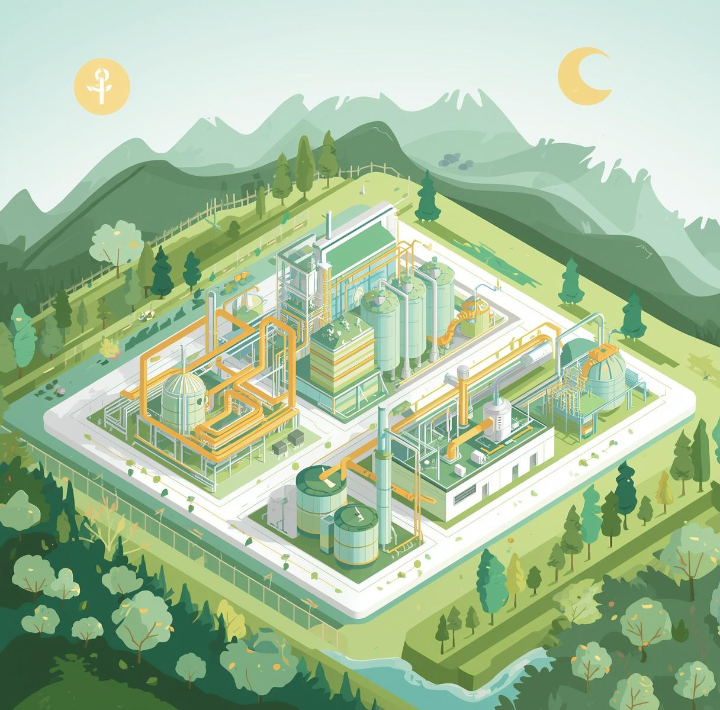
Thank You
AIDA would like to explore this opportunity
Email: president@aidaindia.org
Website: www.aidaindia.org

