Slide 1

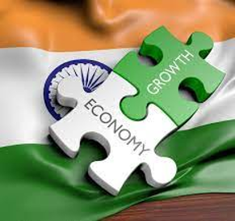

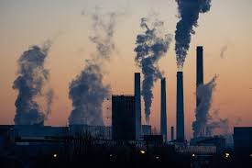
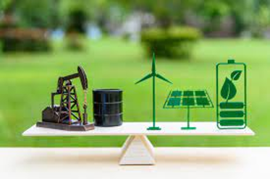



India’s Goals, Energy & Emissions Forecast
Energy Independence
by 2047
Manufacturing & Jobs
India targeting manufacturing contribution to GDP from 16% to 25% (additional 70 Mn Jobs)
Today, 87% of oil consumed is imported. Fossil fuel import bill to triple by 2040
Developed Country by 2047
Carbon Net Zero
by 2070
India’s oil demand to rise by 4 MB/day & Energy use in cars to quadruple by 2040
40% of increase in CO₂ emissions in total transport sector to come from Cars.
India will require multiple energy pathway to achieve its economic and environmental goals at both speed and scale

Slide 2
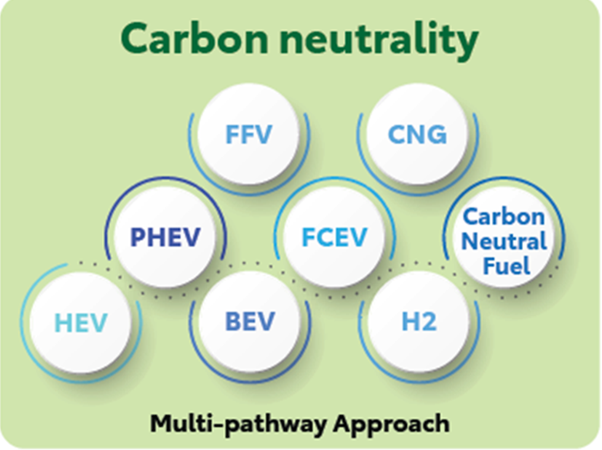
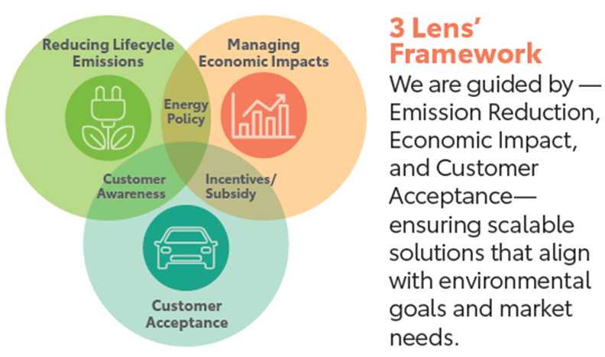
Multi Pathway towards Sustainable Mobility
Tech is a means to an end
S
Tech choice should be based on each country’s unique requirement, its strength, energy mix, infra-readiness & consumer acceptance

Slide 3
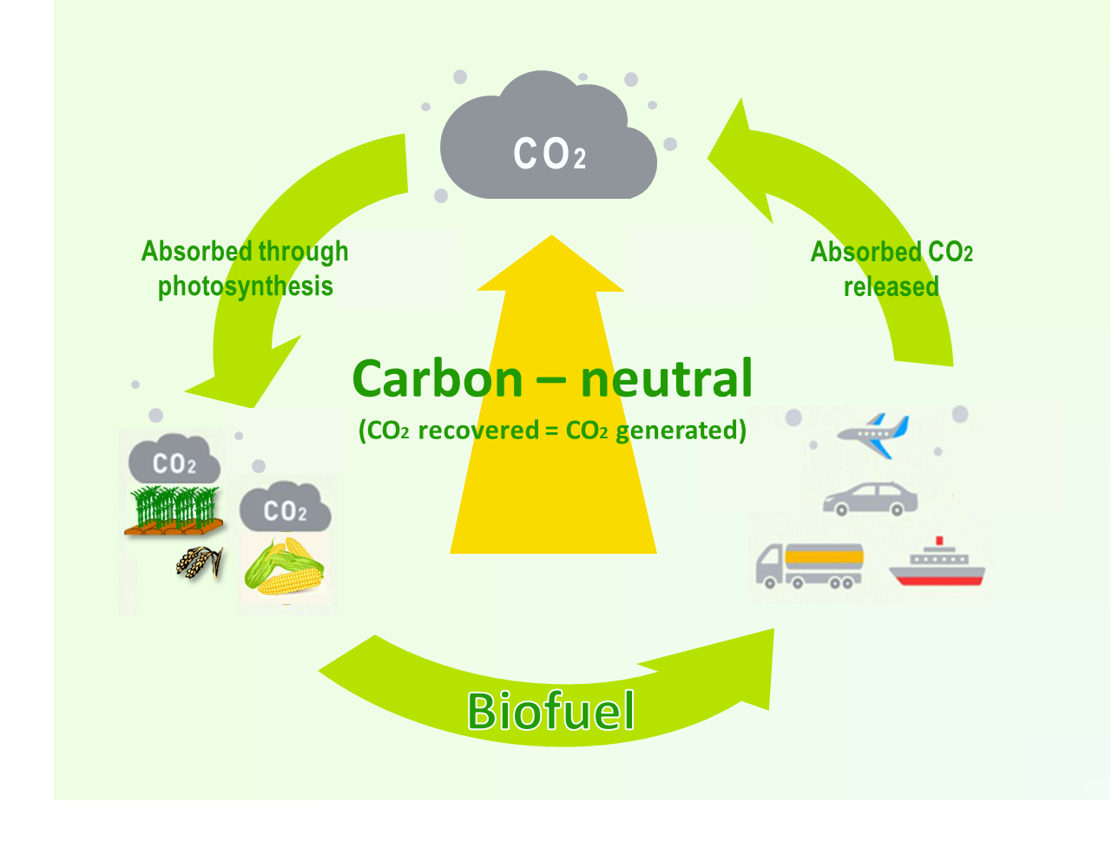

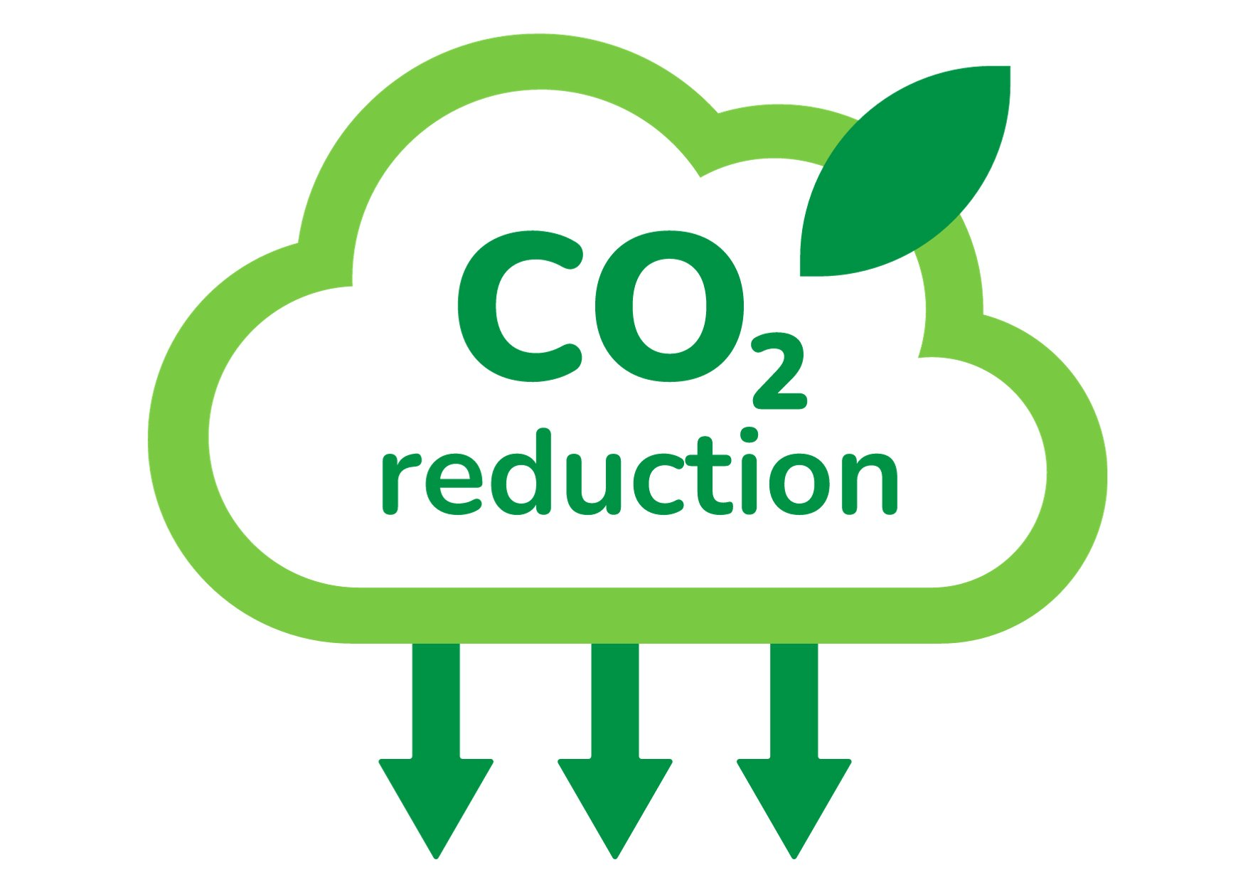
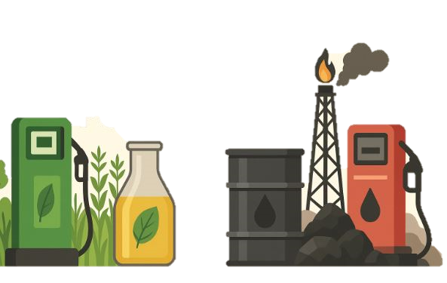

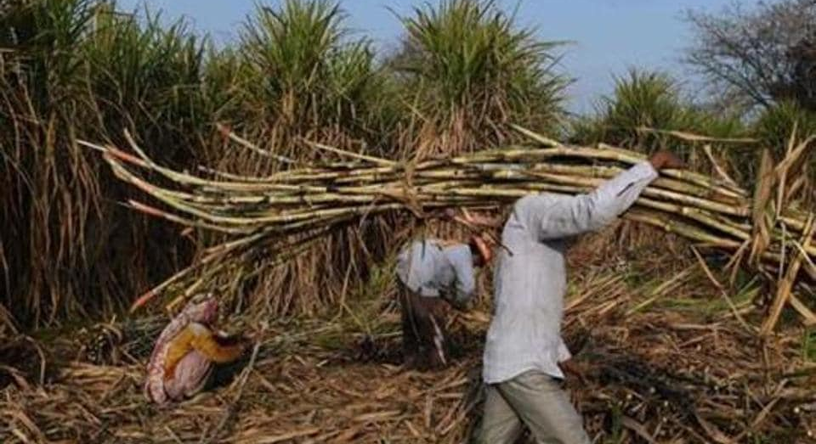
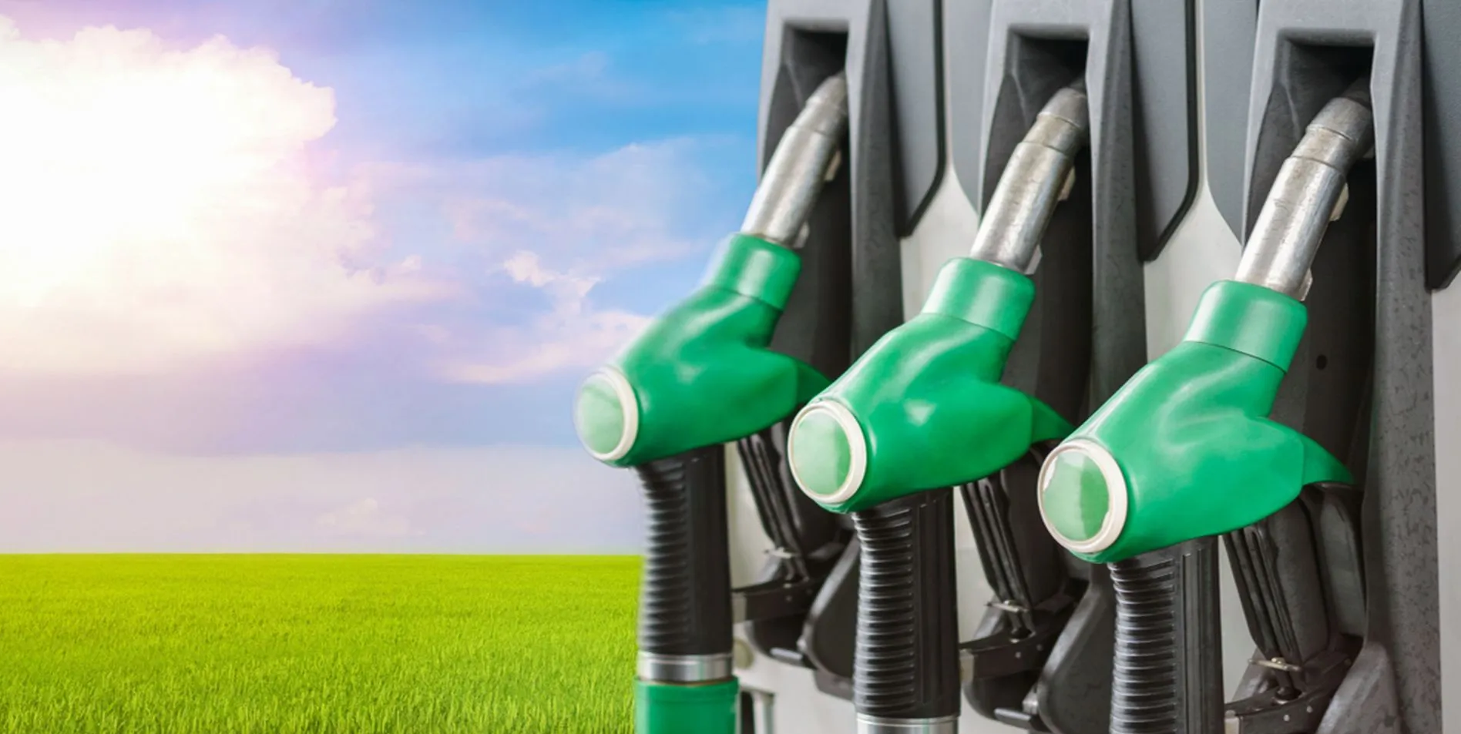
Ethanol: Clean, Green & Scalable Fuel Choice
Improvement of Air Quality
Reduction of GHG Emissions
Transition away from reliance on Fossil Fuel
Trade & Geo-Politics
Increase Farmers Income/Employment
Utilization of Existing Infrastructure
Ethanol is a carbon neutral fuel
Ethanol has huge benefits beyond CO2 reduction
Ethanol is a carbon neutral fuel
Ethanol is bringing sustainable transition across the world, esp. in Global South

Slide 4
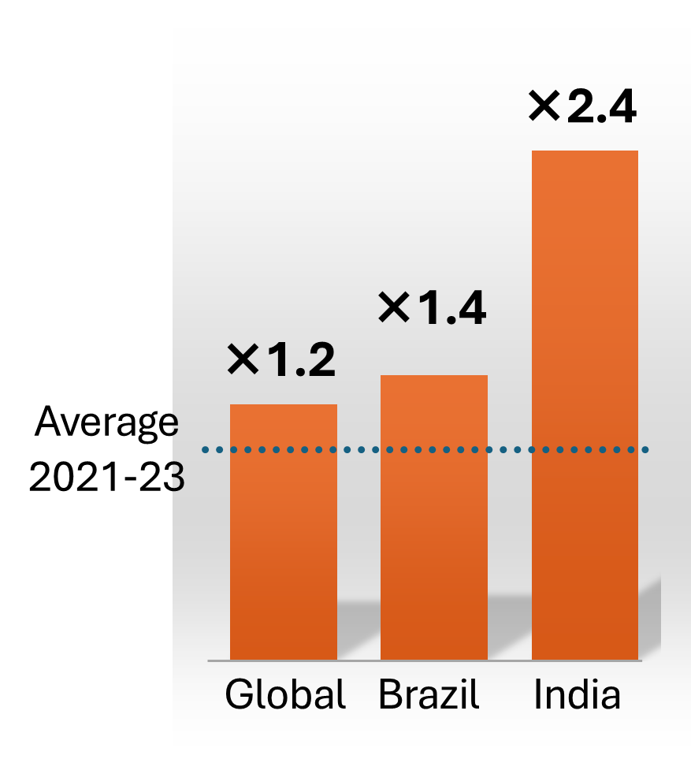
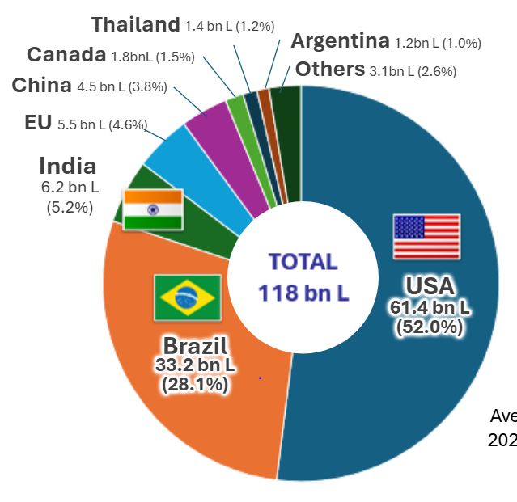
Ethanol: Scaling worldwide & India emerging as a leader
Global Ethanol Fuel Production (2024)
India: Outcomes of Ethanol Blending Program
13X (From 1.5% to 20%)
Blending %
26 MMT
Crude Substituted
79 MMT
CO₂ Reduced
4X+ (2X In just last 4 Yrs)
Production Capacity
1.55 Lac Cr
Forex Saved
1.36 Lac Cr
Farmers’ Remuneration
COP30
Belem Pledge 4X
Quadruple use of Sustainable Fuels incl. Biofuels by 2035
Ethanol production is increasing globally and 82% is consumed by automobile sector
Ethanol Blending Program (EBP) during 2014-25
Ethanol has emerged as a major indigenous green energy pathway which holds huge future potential for growing economies like India

Slide 5
Huge Ethanol Supply Potential in India
ESY 2025-26
ESY 2025-26
1350 Cr Lt
Total Demand
1050 Cr Lt
EBP Demand
1775 Cr Lt
Supply (Offer against OMC bidding)
1900 Cr Lt
Capacity Reached
As per
OMC Tender
There is a surplus supply of Ethanol which has to be leveraged to enhance benefits
Diversification of feedstock has ensured stable and sustainable supply

Slide 6
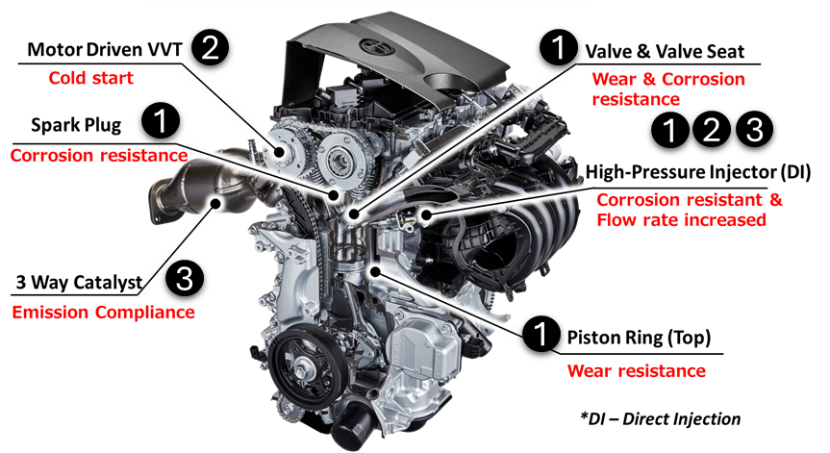
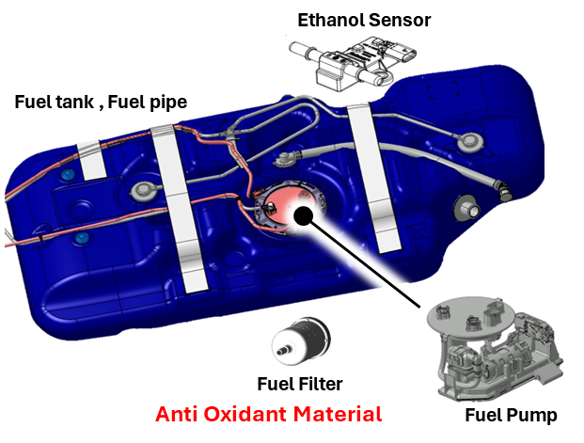
Most OEMs have demonstrated FFV prototypes
Flex Fuel Engine Technology
Engine
Vehicle
1
1
2
Cold Start System
3
3 Way Catalyst & ECU Programming
Needs Corrosive Resistance Material
FFV is developed on ICE vehicle with certain modifications in engine and vehicle to use higher blends of Ethanol in a flexible manner

Slide 7
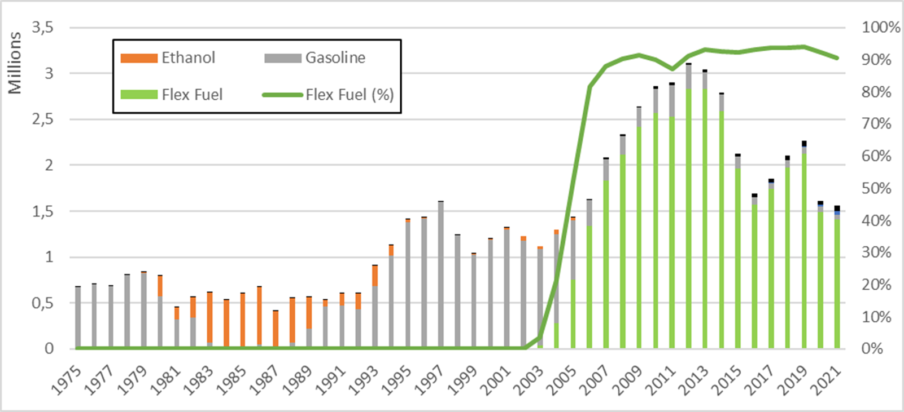
FFVs enabled higher utilization of Ethanol in Brazil
1st FFV Launch
Pure Ethanol (E100) cars market affected by fluctuation in ethanol supply, etc.
FFV market grew past 90% since 2007 consistently and proved pivotal in building and sustaining the Ethanol economy in Brazil.
Source: ANFAVEA

Slide 8
Policy Enablers for FFVs and Electrified-FFVs
Global Example
Vehicle Tax in Brazil
1
Provision biogenic nature (carbon neutral) of Ethanol in Regulations
Recognize merits of Ethanol
▼11％
▼46％
Customer should not pay higher tax than conventional ICE
Capex Support
2
Address Customer Acceptance
Opex Support
Running cost parity vis-à-vis base Blend
With right policy support, India can chart its own pathway towards sustainable mobility powered by indigenous green energy sources like Ethanol

Slide 9
Thank you

